Slide 1
OTG Bank
PROG8150/ User Interface Design Principle

Slide 2
Things that we are going to cover
Introduction
UI Research
Information Architecture
Interaction
Usability Testing
Development
Future Scope
Quiz

Slide 3
Introduction
Objective
Efficiency
Effectiveness
Efficacy

Slide 4
Introduction
Objective
OTG Bank in which OTG stands for On The Go Bank.
Objective of our business is that to provide easy and effective way of doing banking transactions.
Our group wants to eliminate one big problem regarding banking. The long wait in the queue for making some transactions and doing something with your account.

Slide 5
Introduction
For our company’s start-up we have come up with a company strategy that we will follow to keep us ahead of the other organization in the same market. There are three things that every strategy should follow and they are :-
Efficiency.
Efficacy.
Effictiveness.

Slide 6
Introduction
Efficiency
By providing uncomplicated transaction payment system we can help the user of our system with an easy process.
Our business will also be providing the ease of division, which implies that when the user selects the option for the regular customer, the system will take the user to the sector that will provide the information regarding the regular customer service.
Productivity of our business will also be inclined by the ability to handle a high amount of transactions per second. For instance, if you allocate memory of 1 Mb to 1 Crypto-Currency and suppose user transfer 600,000 Crypto-Currency that means it is transferring 600,000 Mb of data. The system will manage to handle this transaction without any problem. Even our system will store every transaction form the very first transaction to the last transaction that happened and one can easily search the transaction whenever he/she wants.

Slide 7
Introduction
Efficacy
Our business will provide the user with the privacy of their identity and we will be providing the customer with peer-to-peer connection.

Slide 8
Introduction
Effectiveness
The productiveness will of the organization will be increasing by providing the user of the business with the private network for their transactions, so any third party will not be able to see/modify their transaction in between. By this the trust of the user will increase and it eventually will be resulting in growth of the business.

Slide 9
UI Research
Other company in the same industry provide similar products/service such as InitiativeQ and they provide services such as :-
Today's payment systems (payment cards, cash, wire transfers) are old and outdated, which means we’re all bearing unnecessary costs.
There are many advanced payment technologies and innovations waiting to be deployed.
If someone built a modern payment system that implemented these technologies and somehow got buyers and sellers to adopt it, this system would quickly become popular. It could eventually end up seeing 20 trillion dollars in transactions per year.

Slide 10
UI Research
Age Group
We are focusing on the audience mainly of the age above 16 years old. It will also help the entrepreneur as well as a middle class person in providing financial help. Our business will also help different organizations, industries regarding the financial aid.

Slide 11
Information Architecture
The Domain of our Business is www.otgbank.com
Wire Frame of our business is shown in the pictures in the upcoming slides.

Slide 12
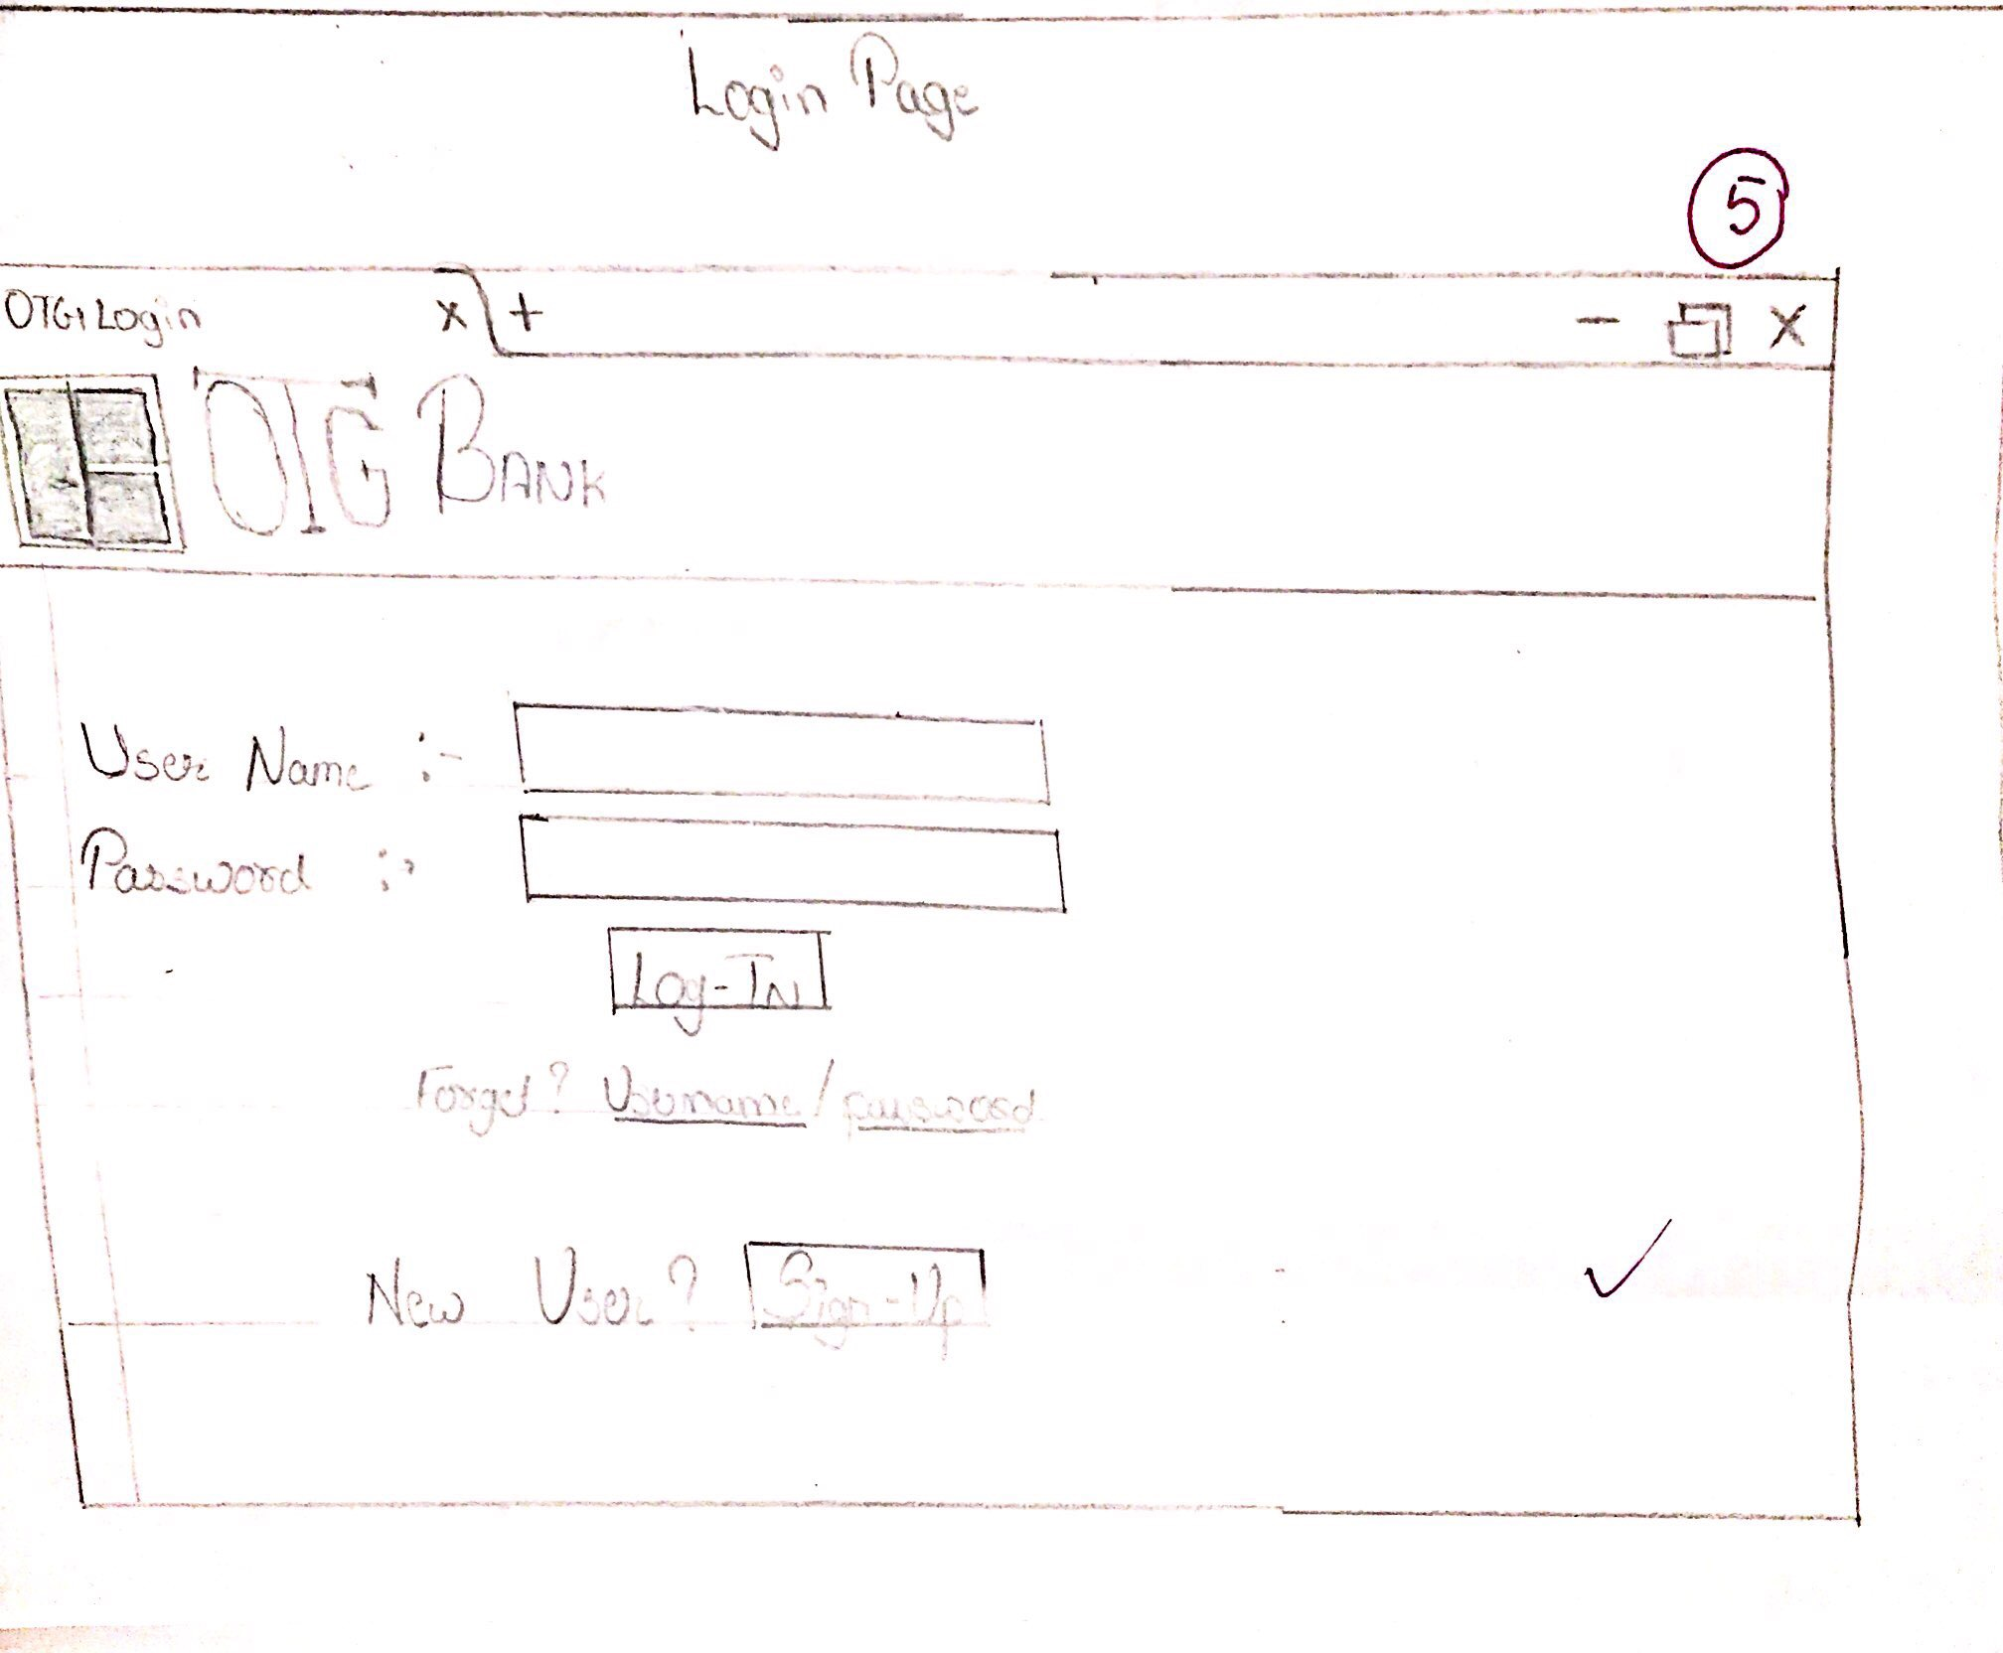
Wire Frame
Login age

Slide 13
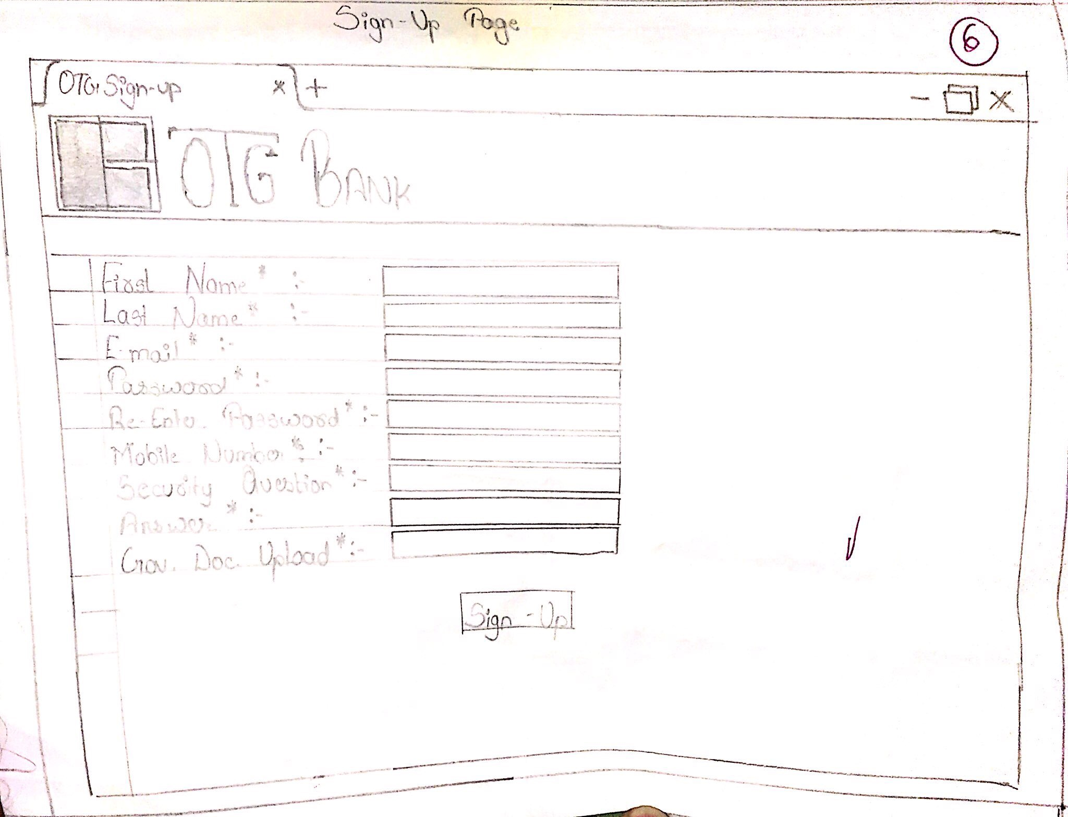
Wire frame
Sign-Up Page

Slide 14
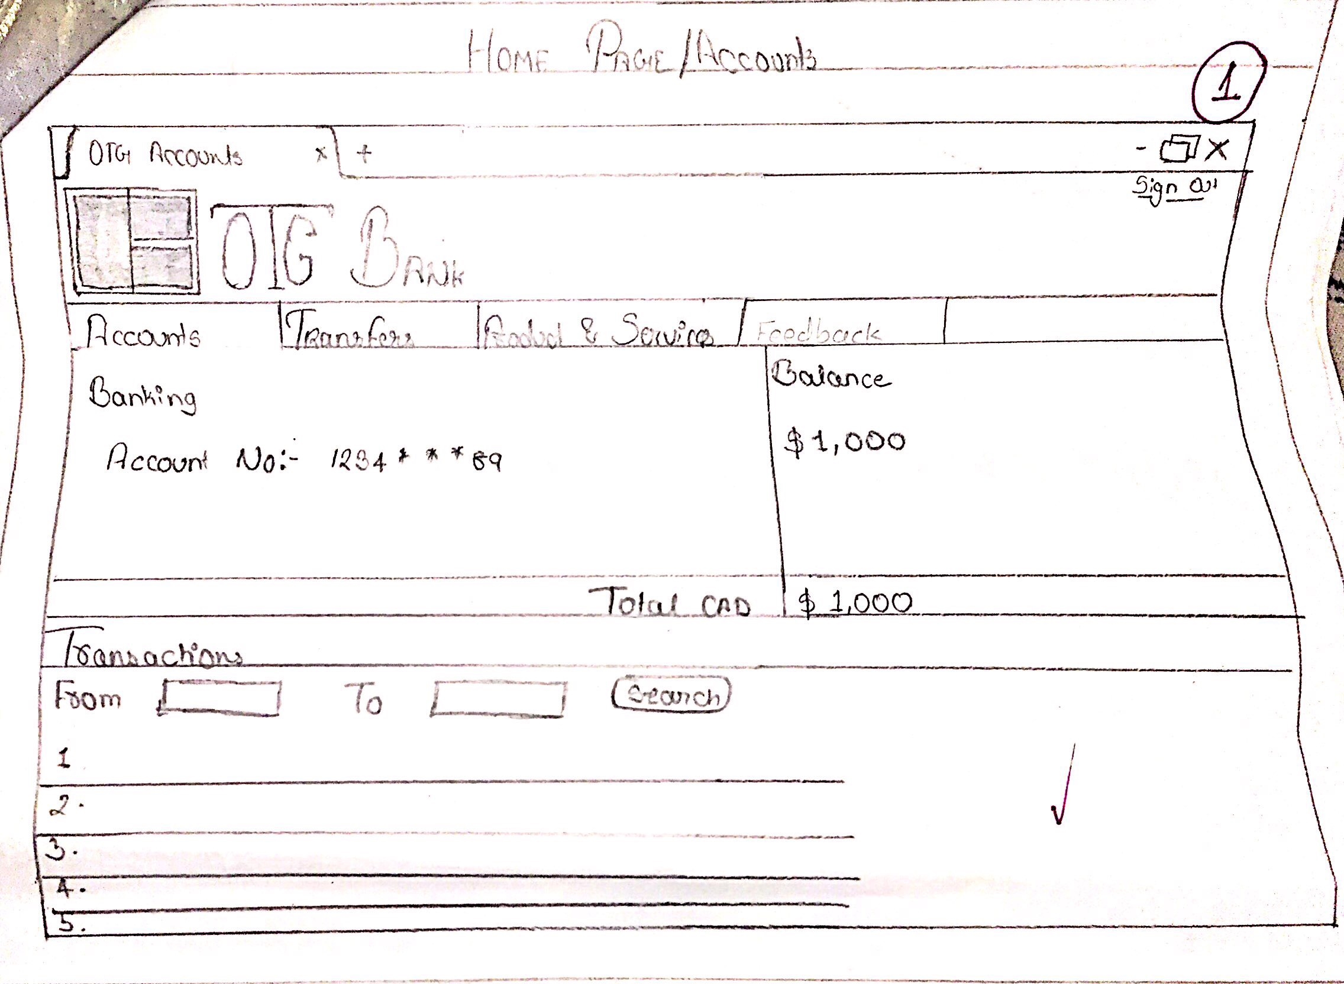
Wire Frame
Accounts Page

Slide 15
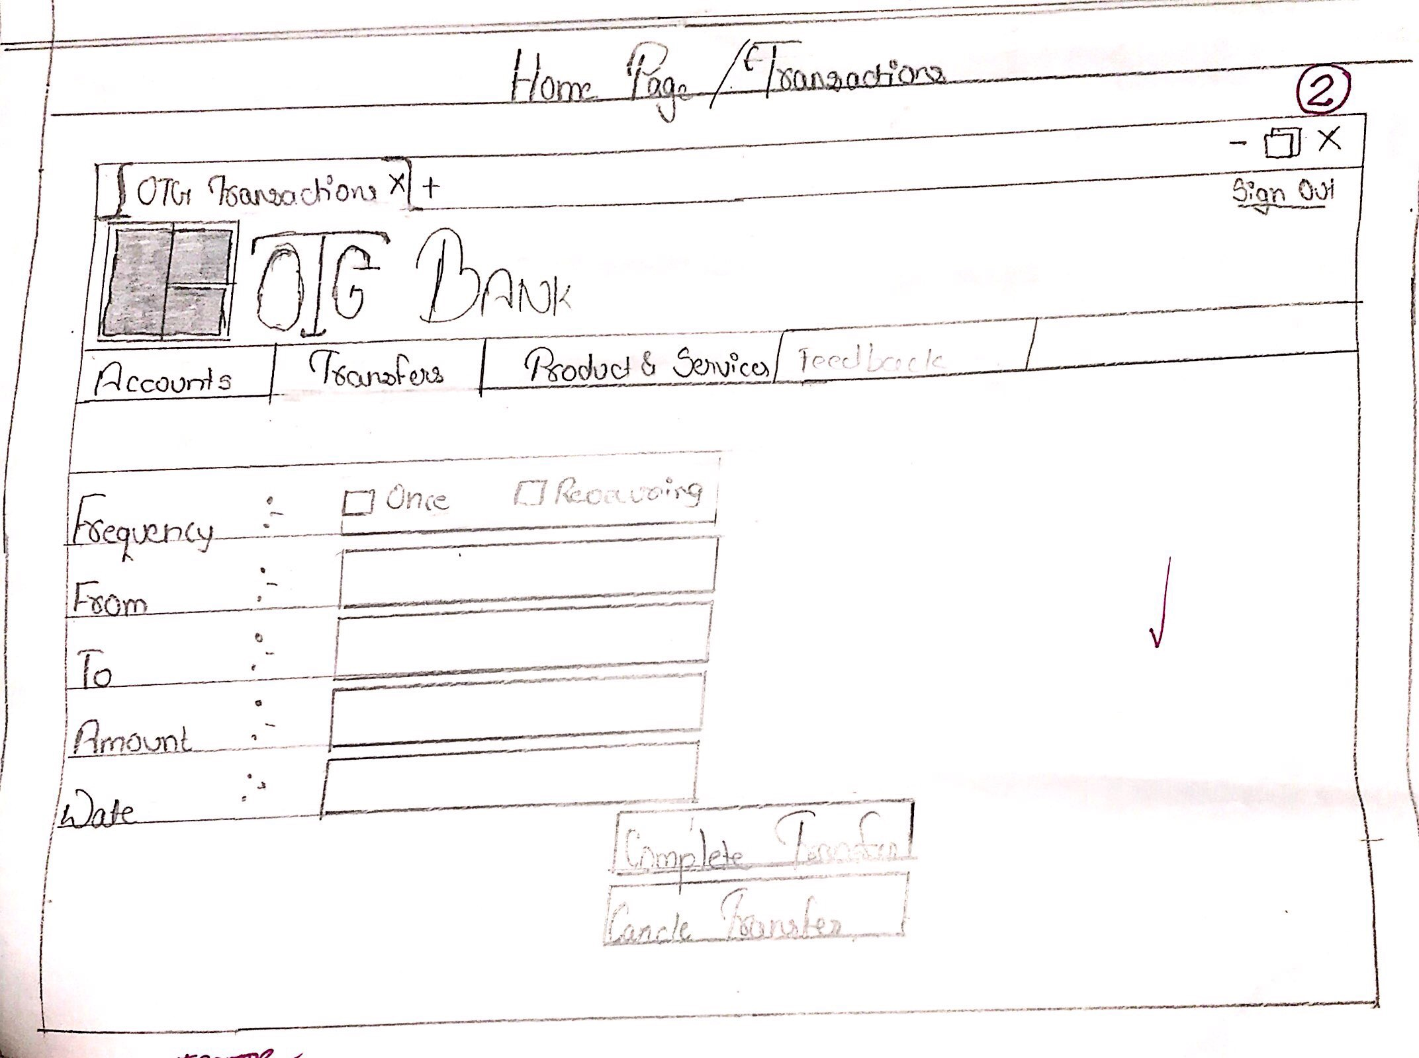
Wire Frame
Transfer Page

Slide 16
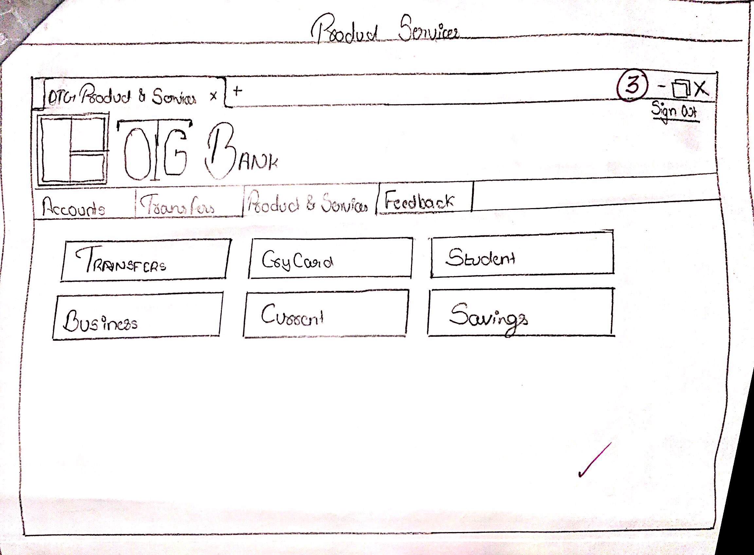
Wire Frame
Product and Services

Slide 17
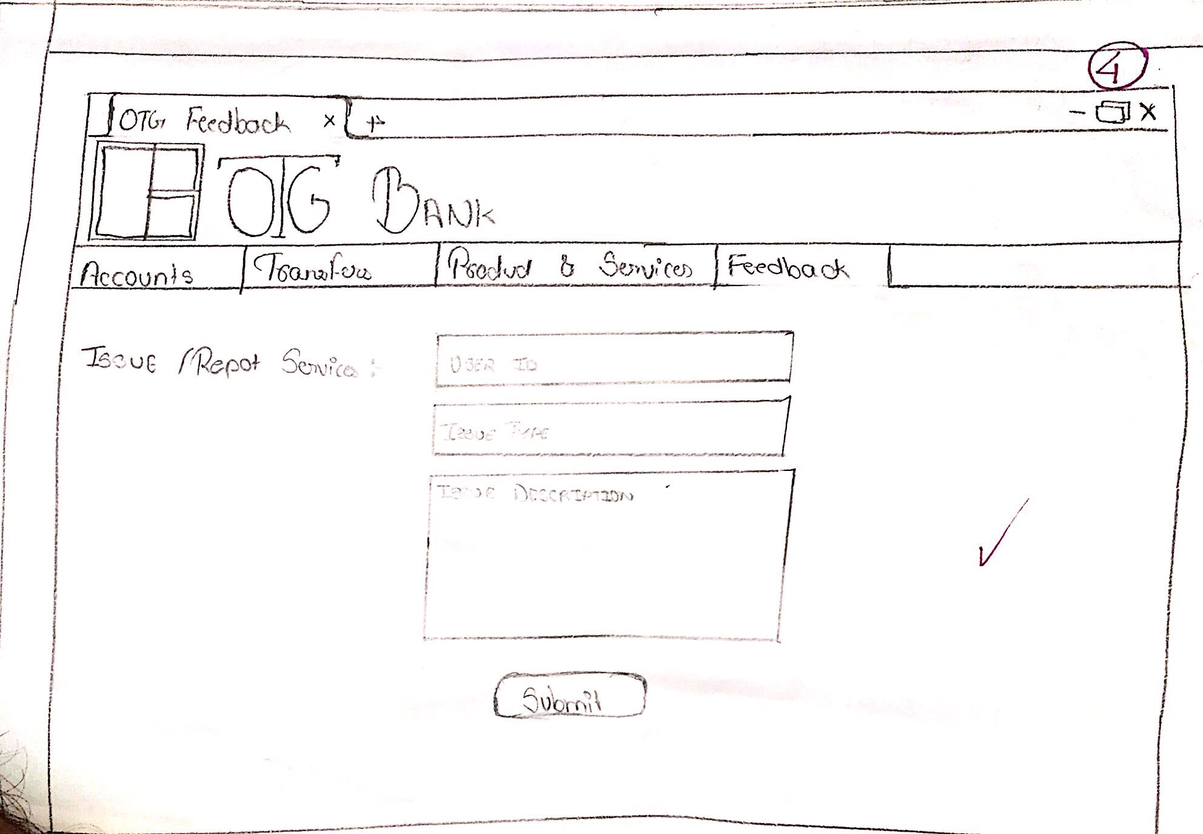
Wire Frame
Feedback

Slide 18
Interaction
We have developed the prototype of our website form to get an idea about what we want to do with our website for and how we want the website to function.

Slide 19
Usability Testing
Google Ad-Words that can be used for our website are as follow :-
Search Ads :-
In this campaign we will use the keywords as :-
Transaction.
Transaction Fees.
E-Wallet.
Crypto Finance.

Slide 20
Usability Testing
Display Ads :-
In this campaign we would use the keywords as :-
Cryptography
Decentralized Exchange.
Cryptographic node.
Predictive Analysis.

Slide 21
Usability Testing
Video Ads :-
In this campaign we would use the keywords as :-
Peer-to-Peer Connection.
Digital Asset.
Block Chain.
Crypto currency market capitalizations

Slide 22
Development Stage
WIX WEBSITE - https://drathod2307.wixsite.com/otgbank

Slide 23
Future Scope
We plan to implement VR and AR in our business to bring a big revolution in the way that people do their financial transaction.
Now you may ask how will we implement AR and VR into the banking business. For the AR we want to implement it as follows:-
This technology will help the new users by showing them how interact with our ATM machines.
In that, when user will open our mobile application, it will come with a feature called Augment Reality.
Also, on our ATM machines, their will be a service which will be identified by our app.
Which will help user to know how machine and service will work.

Slide 24
Future Scope
For the VR we want to implement it as follows:-
The main idea behind using this technology in our business would be, we would implement a whole virtual reality video in our home page of our bank mobile application, the video would be of full customer service experience with departments such as Finance, Banking, Trading, Loans etc.
So, the customer would get a clear idea upfront at home, as a result whenever he comes to our bank, he can process his queries clearly and speedily.
Though he is watching a video from home, but it will be an immersible experience for him interacting to the nearest branch in a whole computerised world.
And as a result, he wouldn’t be in the queue searching out solutions of his queries and the tasks would be completed at pace whenever he visits a branch.
Furthermore, we would also like to implement the Wealth Management of each user in a virtual experience so that he could get a personalized newsroom, meetings with advisors, and portfolio overviews.

Slide 25
Quiz
Q1) How are we going to apply the AR into Bank business?
a) By showing user how to interact with our ATM.
b) By doing banking transaction with AR.
c) None of the above.
Q2) How are we going to Apply the VR into Bank business?
a) By making user play a game into VR and wining some cash.
b) By showing them a video about how our bank works that will help them in the real world.
c) None of the above.

Slide 26
THANK YOU!!
Prepared by :-
Dhruv Rathod(8572307)
Yash Shah(8578430)
Gaurang Babariya (8582975)

